Slide 1
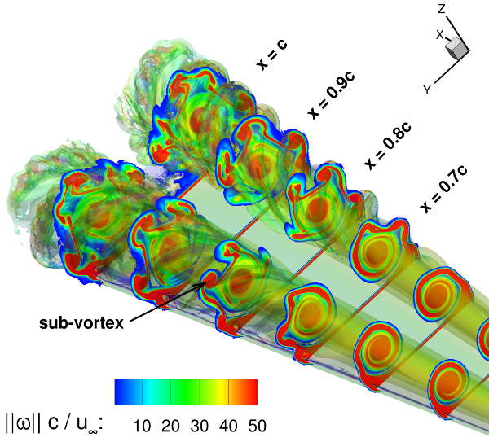


Supraconservative discretization methods for subsonic CFD
Arthur Veldman
University of Groningen

Slide 2
Structure-preserving
Hamiltonian/Poisson | De Rham complex | Invariants
systems & control | differential geometry | conservation laws
dynamical systems | discrete exterior calculus | primary & secondary
symplectic | mimetic | supraconservative
 | (more by Artur Palha) | (several presentations)

Slide 3
Invariants & accuracy
Problem: For many industrial flow problems computers are still too slow
Challenge: Get more accuracy from affordable, coarse grids (no theory known)
Observation: Preserving (primary & secondary) invariants can help:
- energy-preserving methods for long-term weather prediction (1960s)
- finite-volume methods for shock waves (1970s - 1980s)
Goal: Preserve some of the invariants after discretization
→ (supra)conservative methods
Application: Physical flow disturbances and instabilities:
e.g. turbulent flow, acoustics, breaking waves, …

Slide 4
Supraconservative choices
Application
incompressible / compressible (shock waves) / multiphase / shallow-water / …
Invariants?
mass, (linear / angular) momentum, (kinetic + internal = total) energy, helicity,
circulation (Kelvin), pressure equilibrium, dispersion relation, time reversibility, …
2D: integrals of vorticity (enstrophy, …)
Basic variables?
primitive variables / streamfunction-vorticity / velocity-vorticity / √ρ-var^{s} / entropy var^{s} / …
Analytical form?
advective / conservative / rotational / split forms / Jacobians / Hamiltonian / variational / …
Computational grid?
collocated / staggered, (non)uniform / curvilinear / unstructured, particles, …
Discretization method?
finite-differences / -elements / -volumes, spectral, compact, mimetic, LB/SPH/…

Slide 5
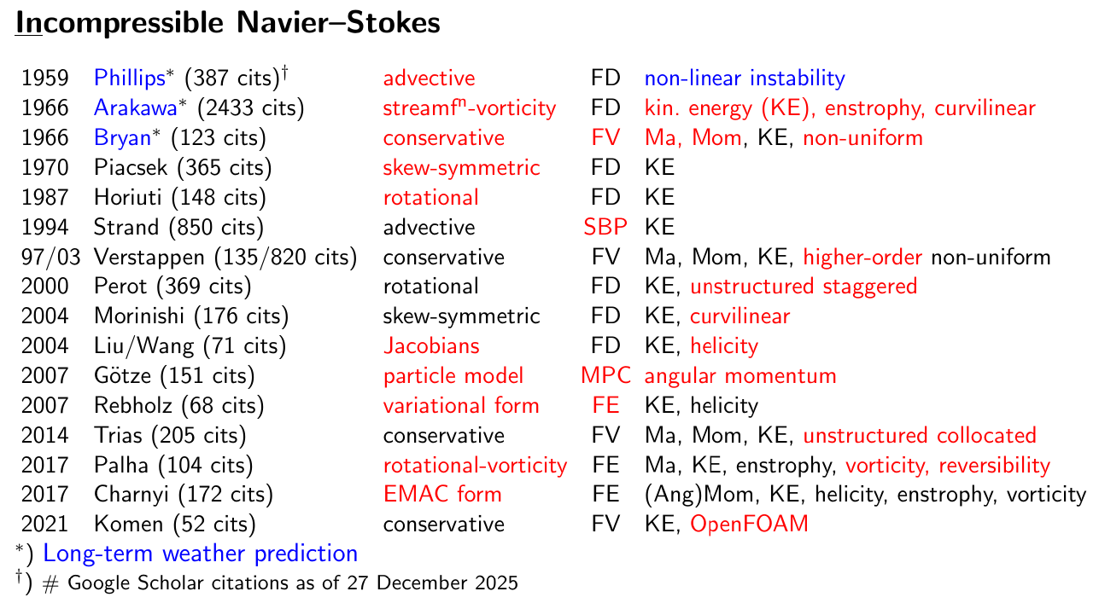
Some secondary-preservation pioneers

Slide 6
How to order this ‘jungle’ of approaches? Go discrete ! Example: Preservation of energy
‘Ansatz’

Slide 7
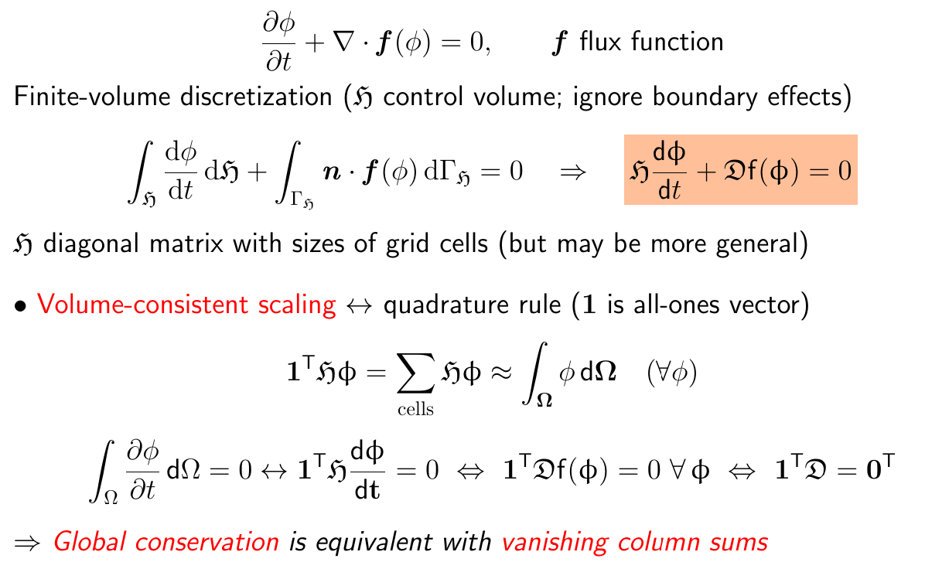
Conservation

Slide 8
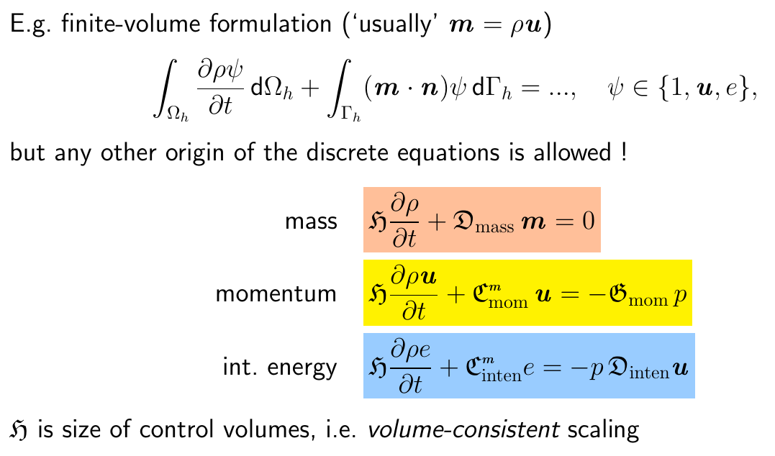
Discrete equations

Slide 9
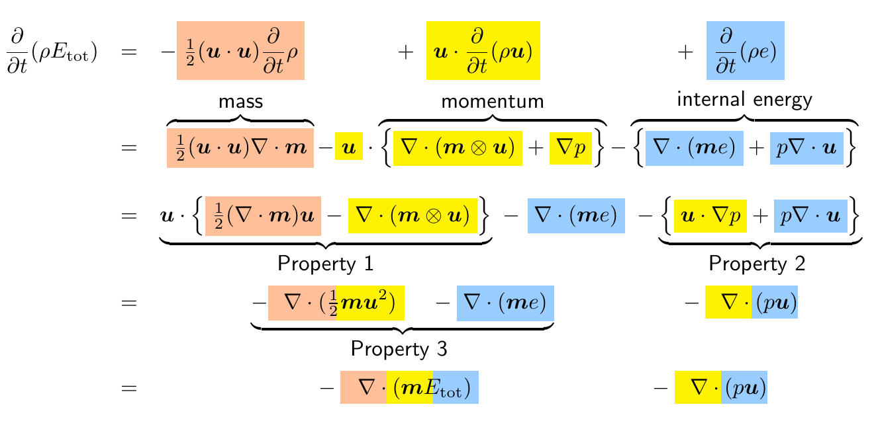
Conservation of energy

Slide 10
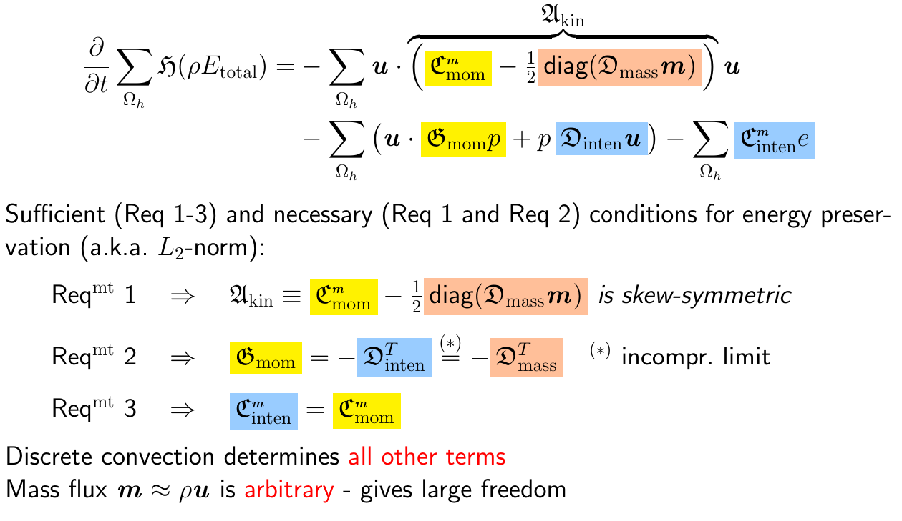
Evolution of discrete energy
AEPV, J. Comput. Phys. 398:108894 (2019); SIAM Review 63:756-779 (2021) .

Slide 11
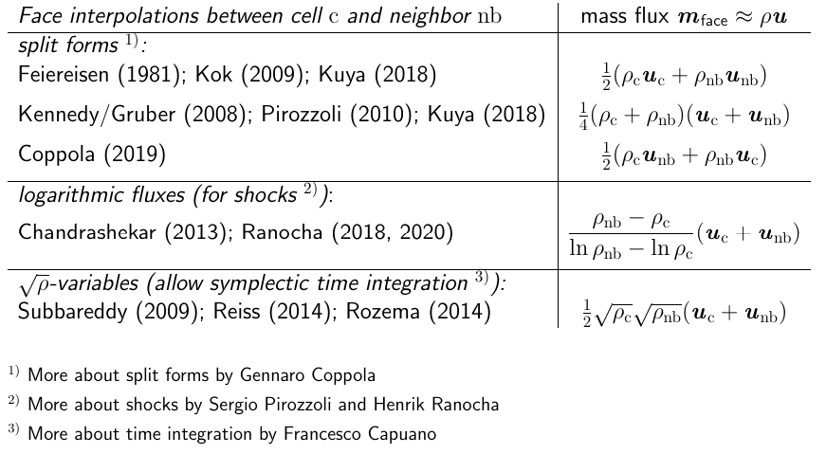
Freedom in mass flux

Slide 12
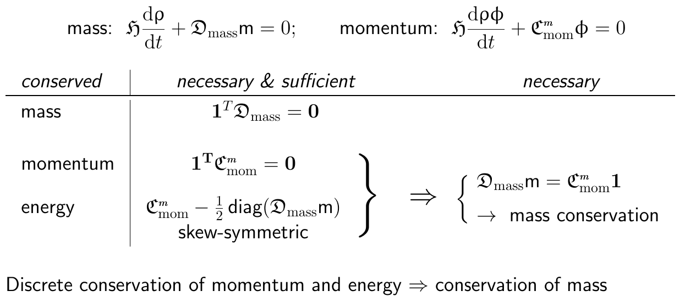
‘Convective’ summary
Discrete equations with volume-consistent scaling

Slide 13
Non-interference
Each physical phenomenon has its own ‘action’
Convection moves ‘stuff’ from A to B; does not change anything
- Linear algebra → eigenvalues purely imaginary = close to instability
- “Non-linear instability” is a misnomer (Bryan also knew this in 1966)
Pressure does work only by compression
For incompressible flow, only viscosity dissipates energy
Shock waves also dissipate energy (compression, entropy, viscosity)
Principle of non-interference
Above properties should also hold after discretization

Slide 14
Discretizations

Slide 15
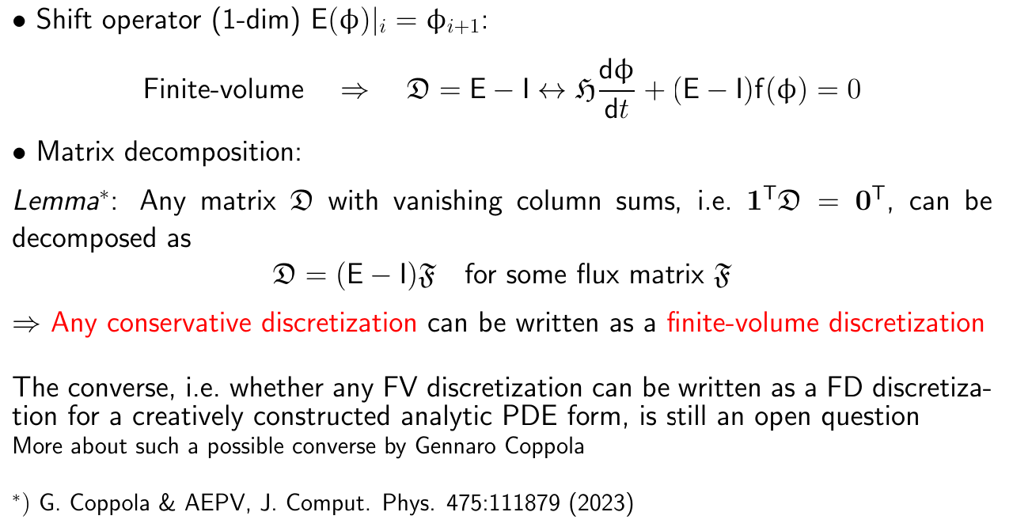
Linear algebra and conservation

Slide 16
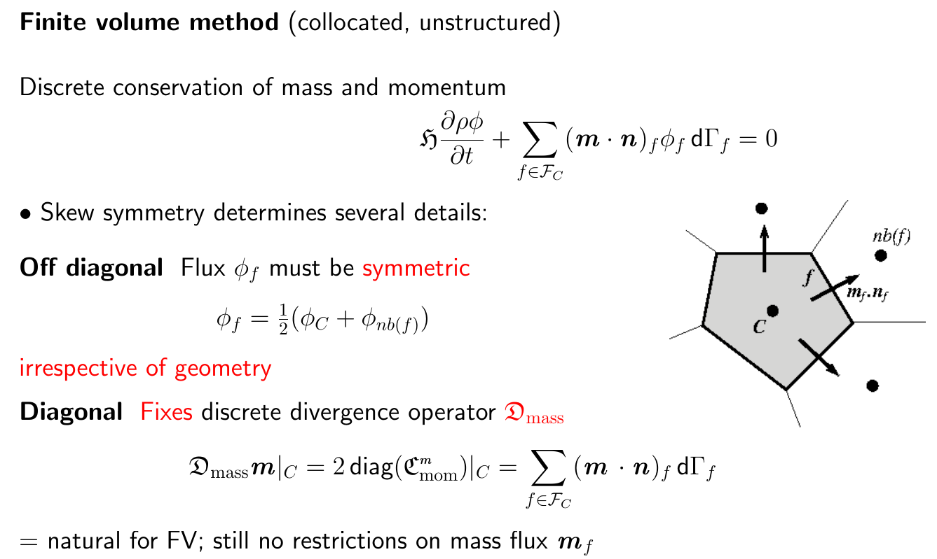
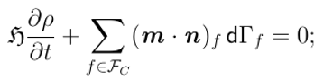
Finite volume: collocated, unstructured

Slide 17
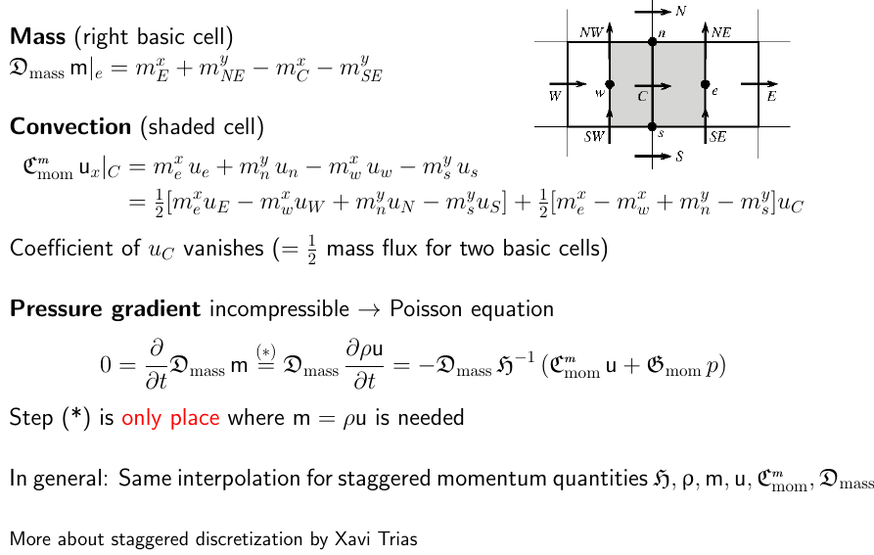
FV: staggered, structured

Slide 18
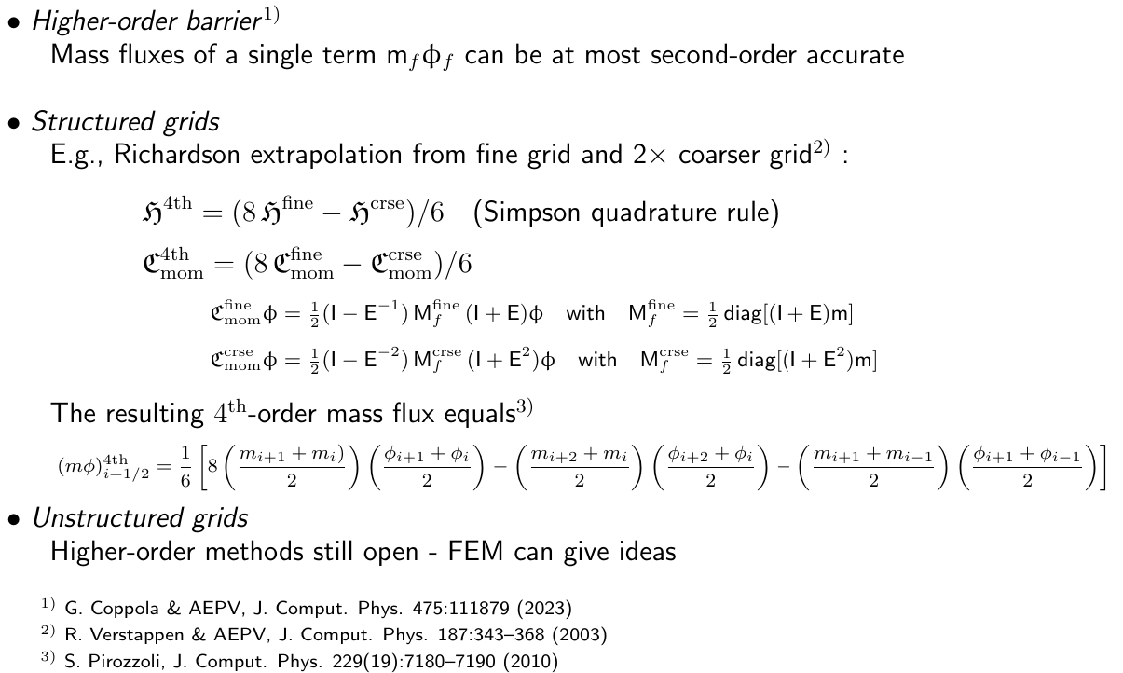
Higher order

Slide 19
Simulations on coarse grids

Slide 20
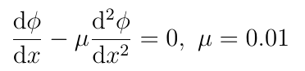
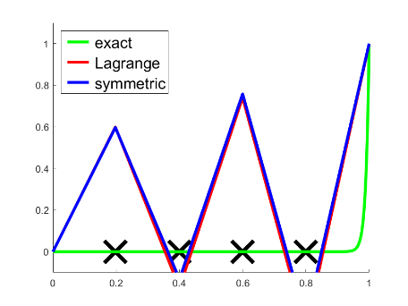
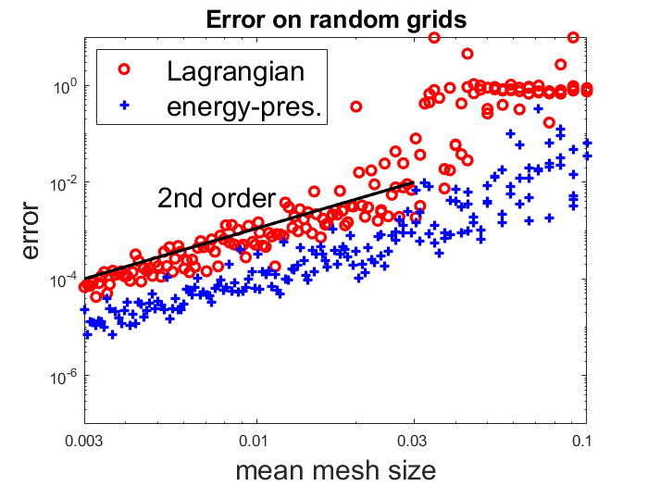
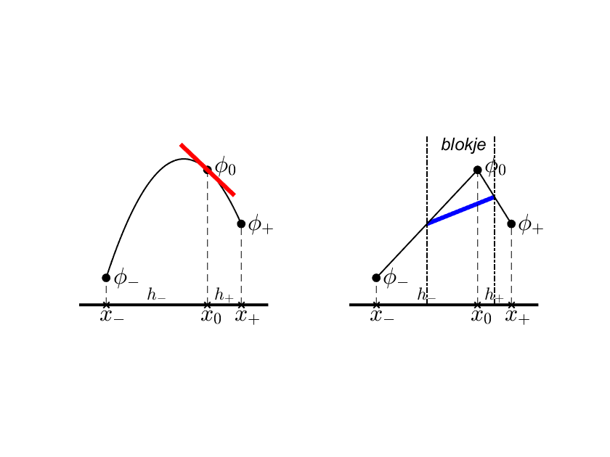
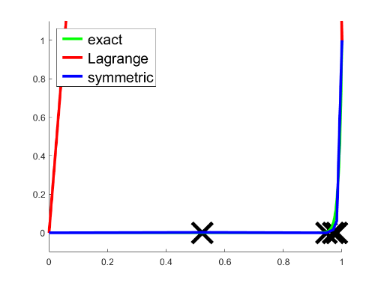
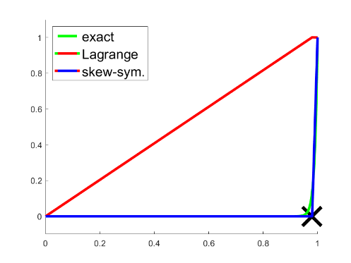
ConvDiff - random exponential grids
,
See also: E. Dobelis, A Comparison of Discretization Methods on Coarse Non-Uniform Grids, BSc thesis, RUG, June2025

Slide 21
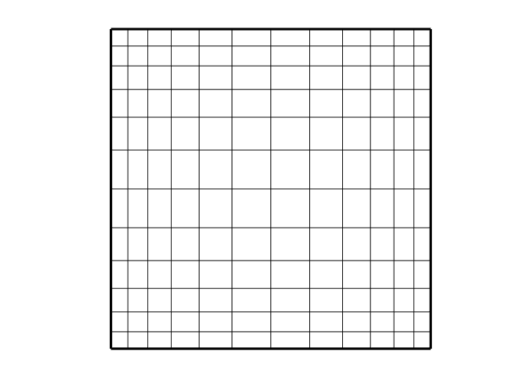
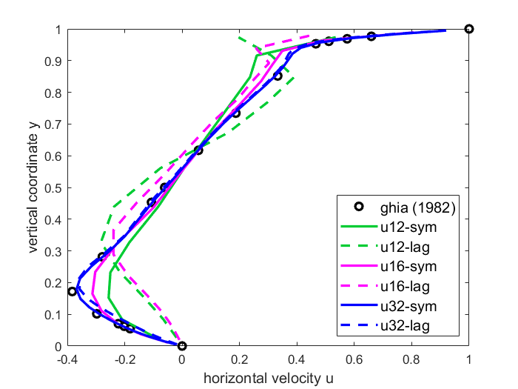
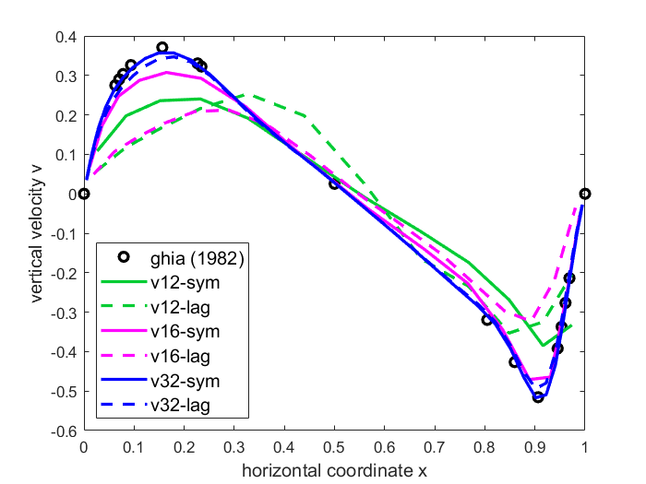
Driven cavity
Driven cavity Re=100 – centerline velocities
non-uniform grids 12x12, 16x16, 32x32
12 x 12 grid
Skew-symmetric ( ) versus Lagrangian ( ) central discretization

Slide 22

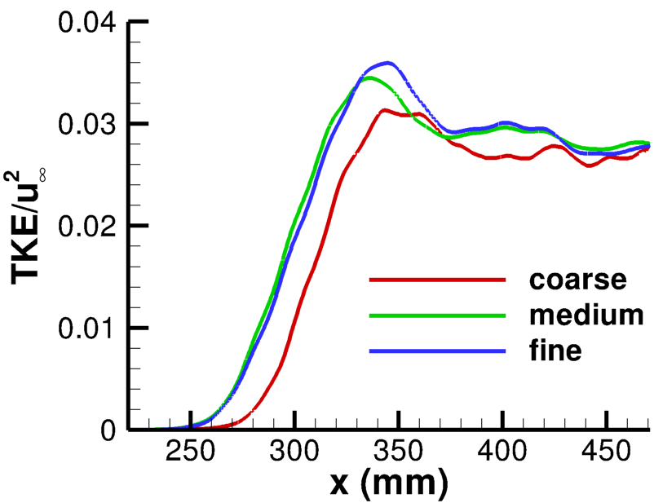

Delta wing: compressible flow
Subsonic flow past delta wing at Re_{c}=150,000 : DNS vs. experiment
Natural laminar-turbulent transition
No artificial diffusion
Turbulent kinetic energy
EXP transition.
TE
W. Rozema, et al. J. Comput. Phys. 405:109182 (2020) .

Slide 23
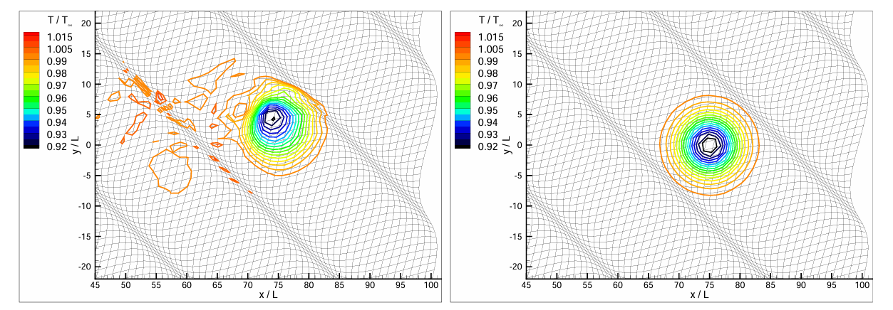
Acoustics (Euler)
Convection of isotropic vortex in uniform flow - Mach = 0.5
Preserves kinetic energy and dispersion relation - ‘supra²conservative’
Standard non-symmetric discretization Skew-symmetric discretizationm
J.C. Kok, J. Comput. Phys. 228:6811-6832 (2009)

Slide 24
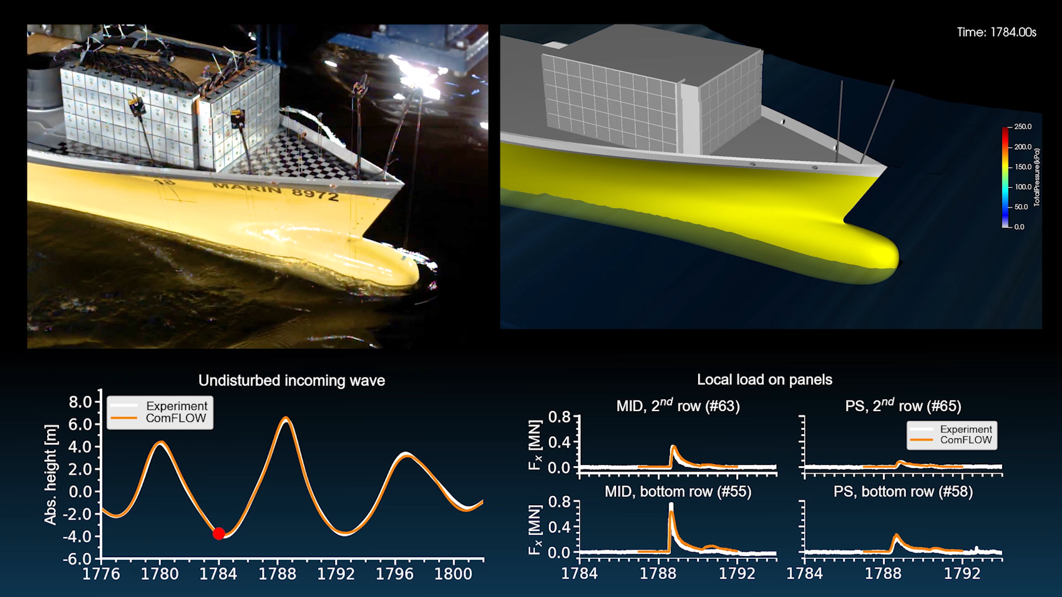

Multiphase flow
Instabilities at tips of breaking waves
Exchange between kinetic, potential and capillary energy
R.A. Remmerswaal, arXiv:2209.14934 (2022); PhD thesis, Univ. Groningen, 2023l

Slide 25
Conclusions
Supraconservative discretization of subsonic NS
- Discussion at discrete level, independent of analytical origin
- FV helps to reduce the ‘jungle’ of secondary-preserving discretizations
- Necessary and sufficient conditions for energy preservation
- Discrete convection determines all other terms except diffusion
- Mass fluxes arbitrary; momentum fluxes ½ - ½ interpolation
- For incompressible flow, provably stable without artificial diffusion
- Forgiving to irregular, coarse grids – more theory desired

Slide 26
Research themes
- How to combine this philosophy with turbulence modelling?
More by Andrea Beck, Benjamin Sanderse and Roel Verstappen
- How to combine analysis with (energy dissipating) shock waves?
More by Francesco Capuano, Gennaro Coppola and Sergio Pirozolli
- How to design higher-order variants for unstructured grids?
More by Oriol Lehmkuhl and Xavi Trias
- How to combine geometric flexibility of FEM with supraconservation of FVM?
More by Alessandro Colombo and Artur Palha
Which secondary invariant is most suited for a given application on coarse grids, and can it be analysed in a similar way ?
- What does this approach imply for the Jacobian matrix (bifurcations)?
- How to transfer new CFD approaches to industrial software?
More by Pedro Costa, Ed Komen, Henrik Ranocha and Francesc Verdugo

